Slide 1
CEE 6501 Final Project
By: Wynn Harrow

Slide 2
Presentation outline
GitHub and Code Structure
User Input
DSM Solver Workflow
Validations
Complex Structure Study

Slide 3
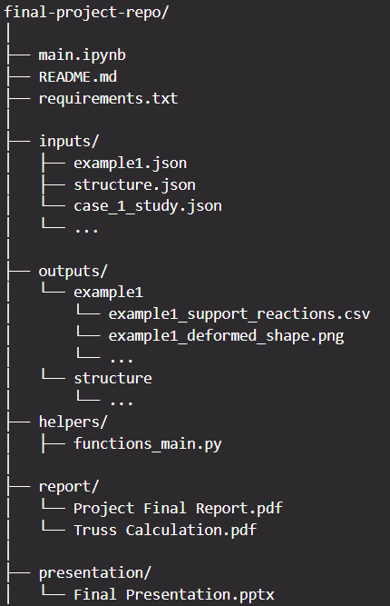
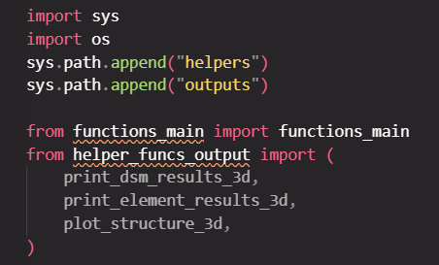
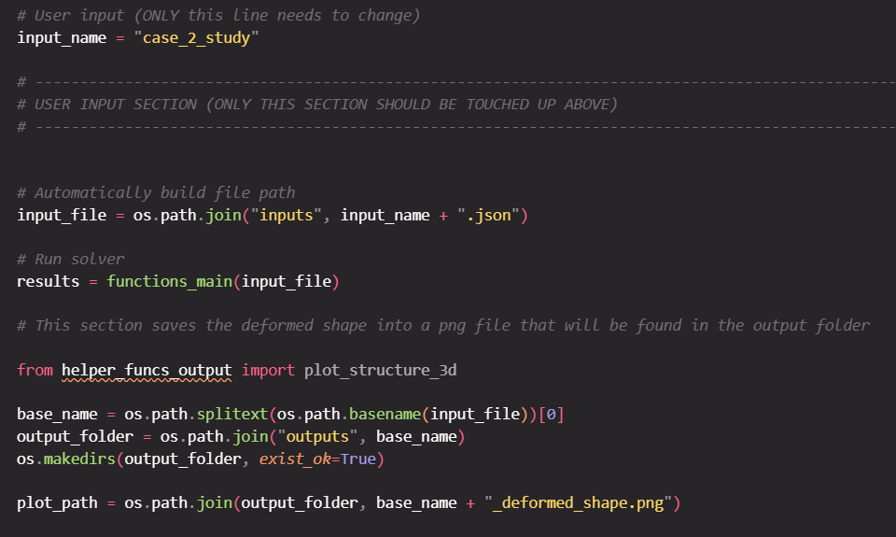
GitHub and code structure

Slide 4





User input
x, y, z
ux, uy, uz, rx, ry, rz
Fx, Fy, Fz, Mx, My, Mz

Slide 5


User input
ux, uy, uz, rx, ry, rz

Slide 6
DSM Solver Workflow
Reads the .json input files
Define Global Degrees of Freedom (DOF)
Element-Level Calculations
Compute Equivalent Nodal Loads (FEFs)
Assemble Global System
Build Global Load Vector
Apply Boundary Conditions
Solve System of Equations
Compute Support Reactions
Recover Element Forces
Post-Processing & Output

Slide 7
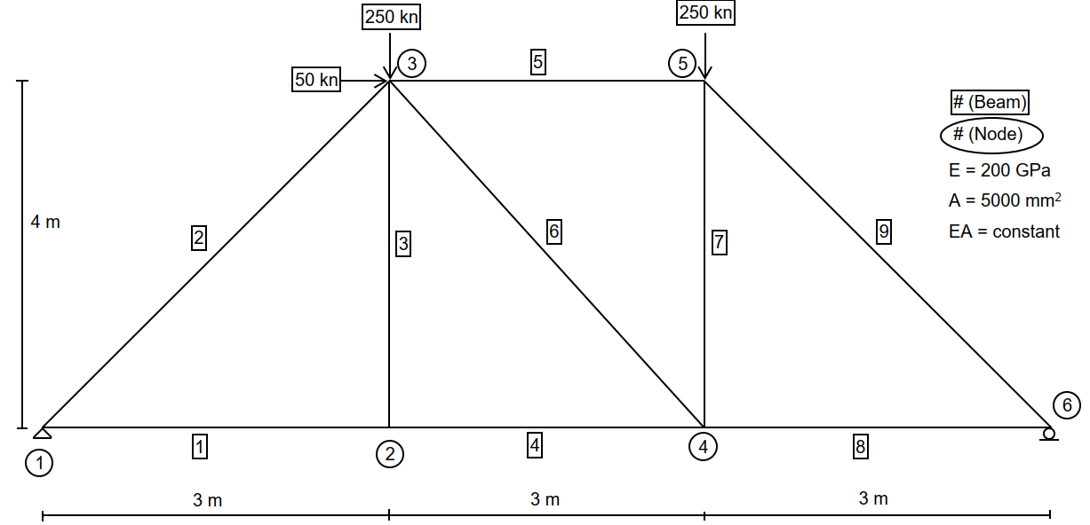
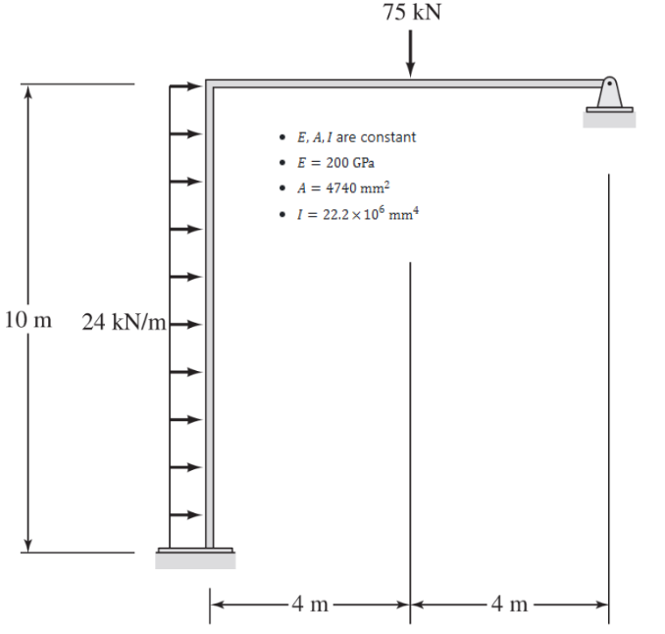
Validation
Example 1 Example 2

Slide 8
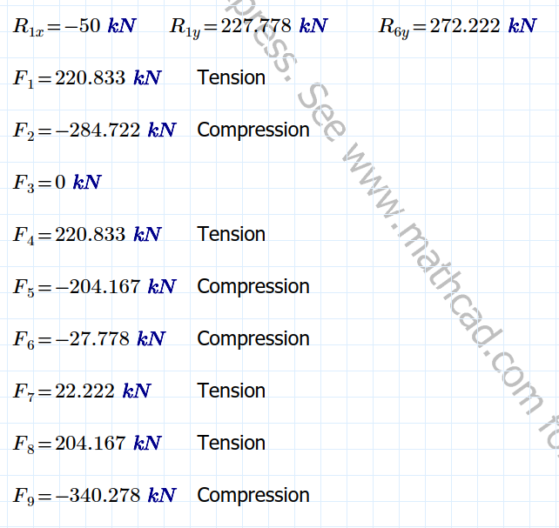
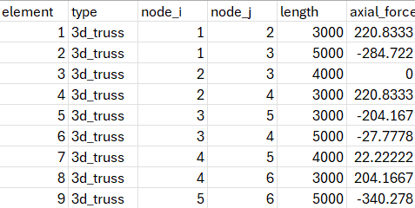
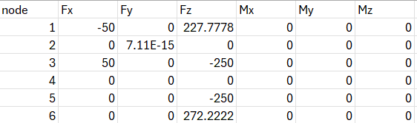
Example 1
Analytical Results Computational Results

Slide 9
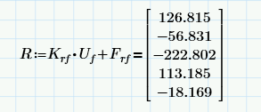

Example 2
Analytical Results Computational Results
Results are close but not exact
Differences due to:
3D model vs 2D hand calculation
Additional DOFs
Modeling input

Slide 10
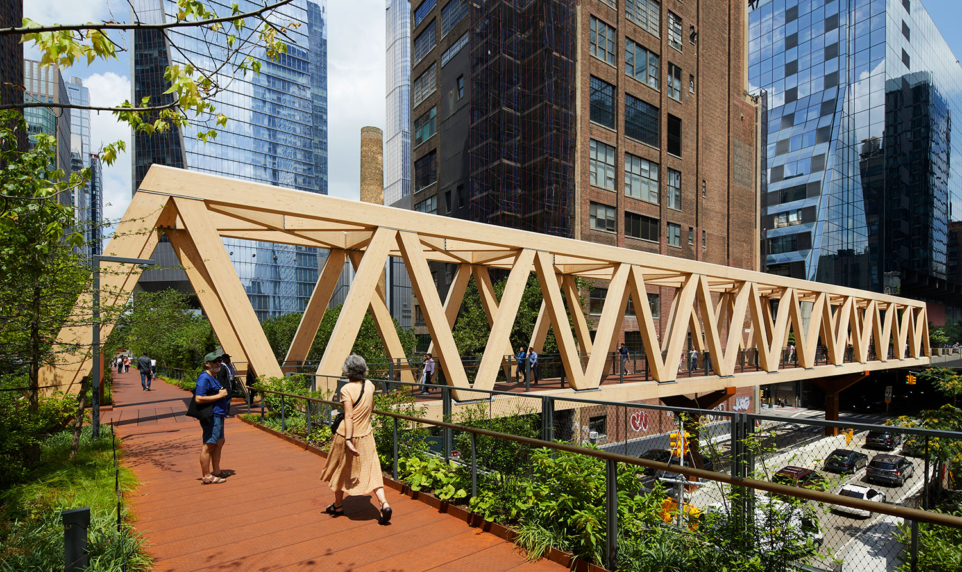
Complex structure study
High Line Moynihan Connector
Located in NYC (2023)
Two Sections (Steel Viaduct and Timber Bridge)
260 ft span, 20ft height, 15.5 ft width
Frame Elements for main longitudinal and transverse members
Truss Elements assigned to diagonal members
Why?
Take a bridge and apply truss and frame elements
Perform Two Case Studies
Case 1: What are the effects during a Polar Vortex?
Case 2: What if received a bad batch of timber

Slide 11
Key decisions
Structural Idealization
Modeled bridge using 3D frame + truss elements
Element Type Selection
Allowed users more flexibility in choosing member type
Boundary Conditions
Fixed DOFs [u_{x}, u_{y}, u_{z}, r_{x}, r_{y}, r_{z}] where base nodes fully restrained
Geometry Simplification
Material Assumptions
Linear Elastic Behavior
E, A, I assumptions
Load Case Selection

Slide 12
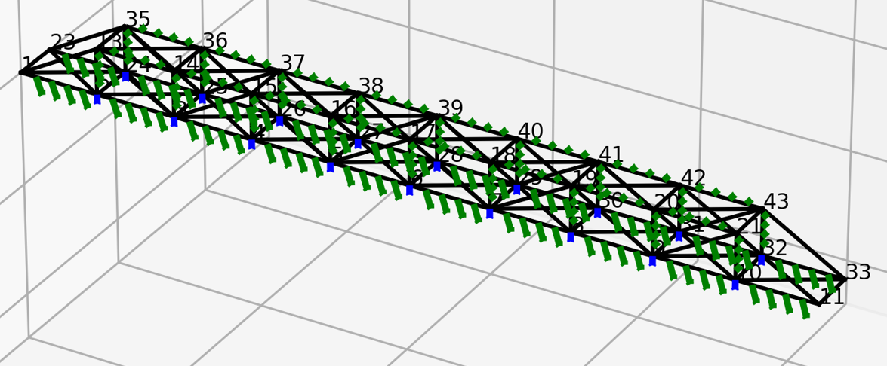
Loads applied
Applied 2 kips at each node for gravity loads (pedestrians and deck weight)
Applied additional -0.5 kip/ft member gravity loads
Applied -0.15 kip/ft transverse loads (wind)
Loads were chosen as realistic approximations based on typical bridge loading, then simplified

Slide 13
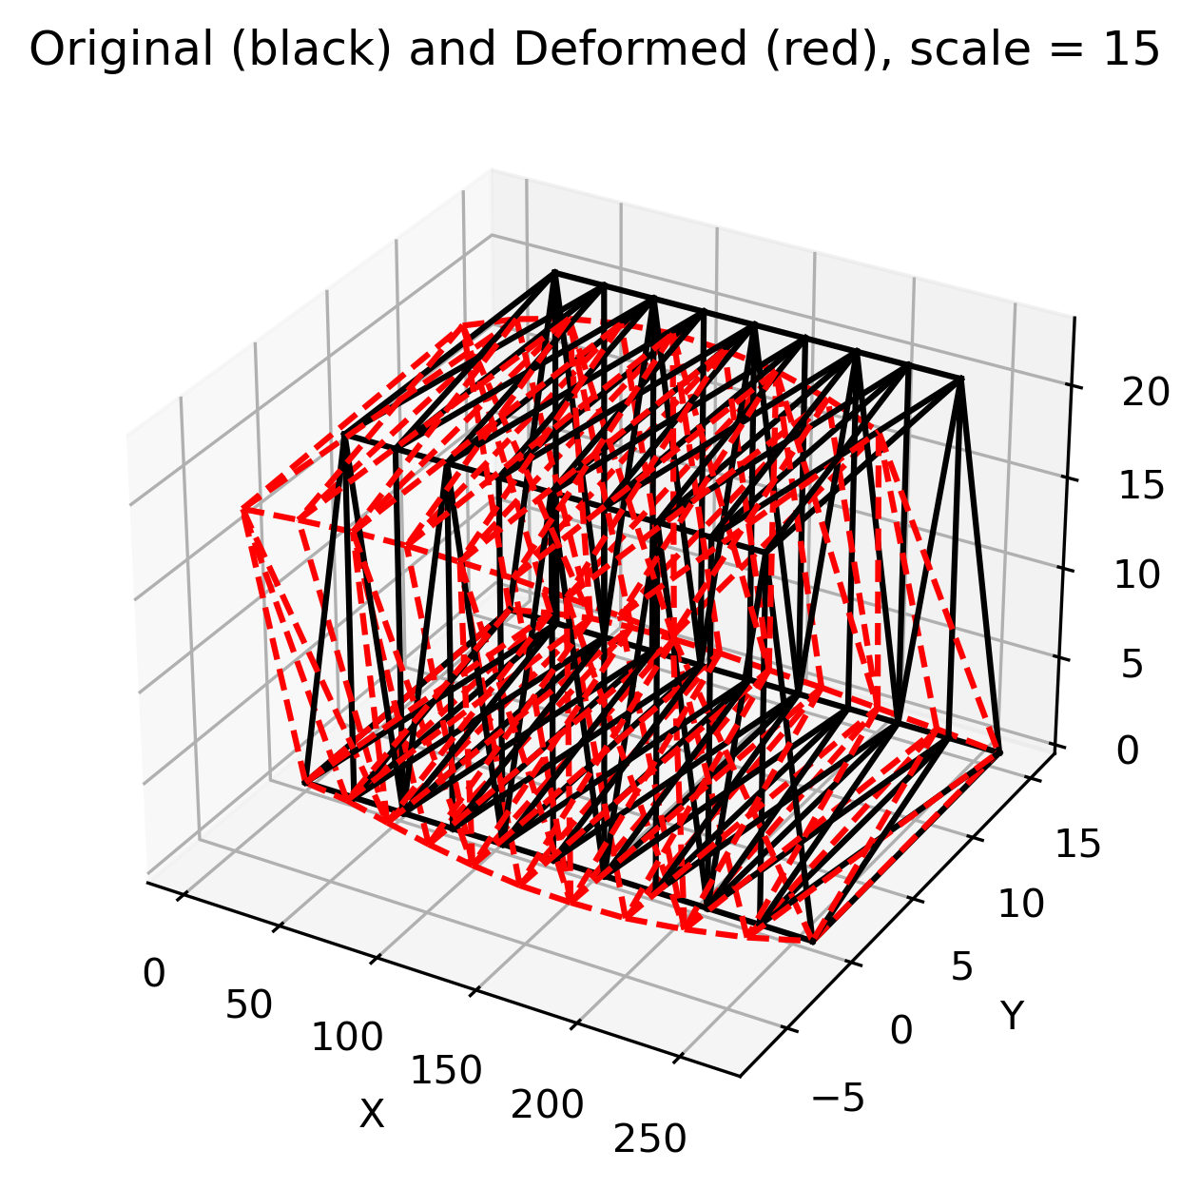
Base structure results
Largest displacement: -0.461 ft in the transverse (y) direction
Result is unexpected
Gravity load should be governing
Structure Input Possibilities
Largest Axial Load: 404 kips

Slide 14
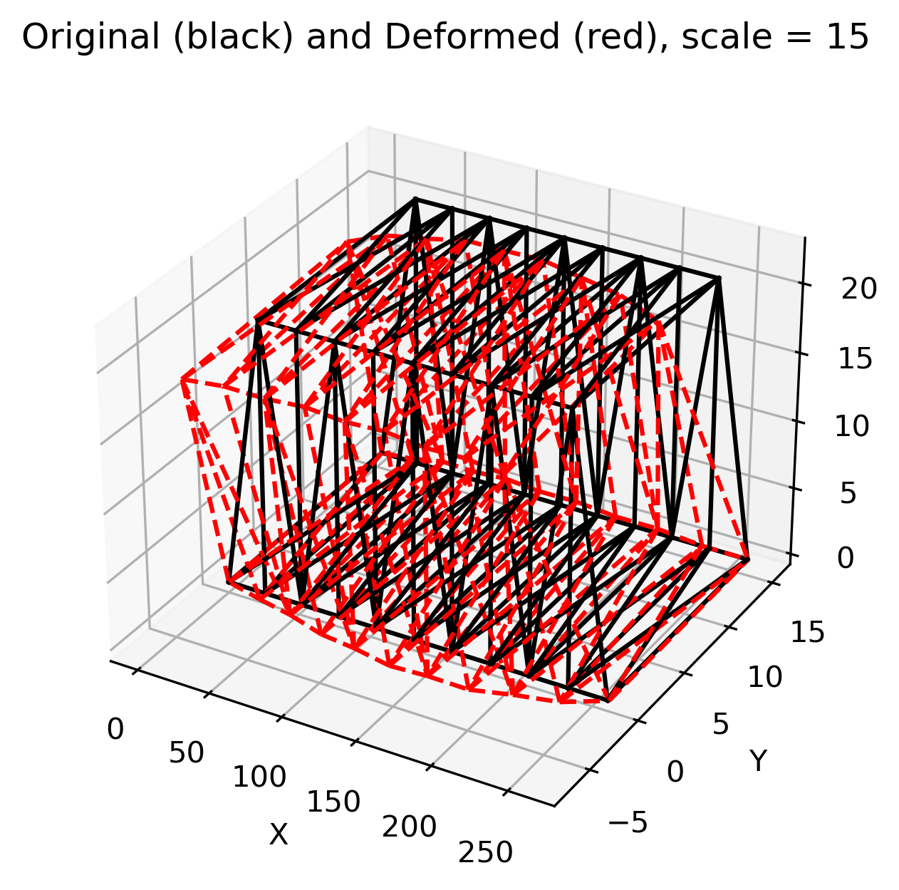
Case 1 results
Polar vortex dropping temperatures to -40 degrees Fahrenheit
Assuming Delta T change of 100 degrees colder
Largest displacement: -0.642 ft (very similar to base study)
Largest axial load: 654 kips (significantly higher than base study)
Key things learned:
While being fully restrained, members will want to contract
adding additional axial stress on the members
Overall shape of the structure will stay relatively the same

Slide 15
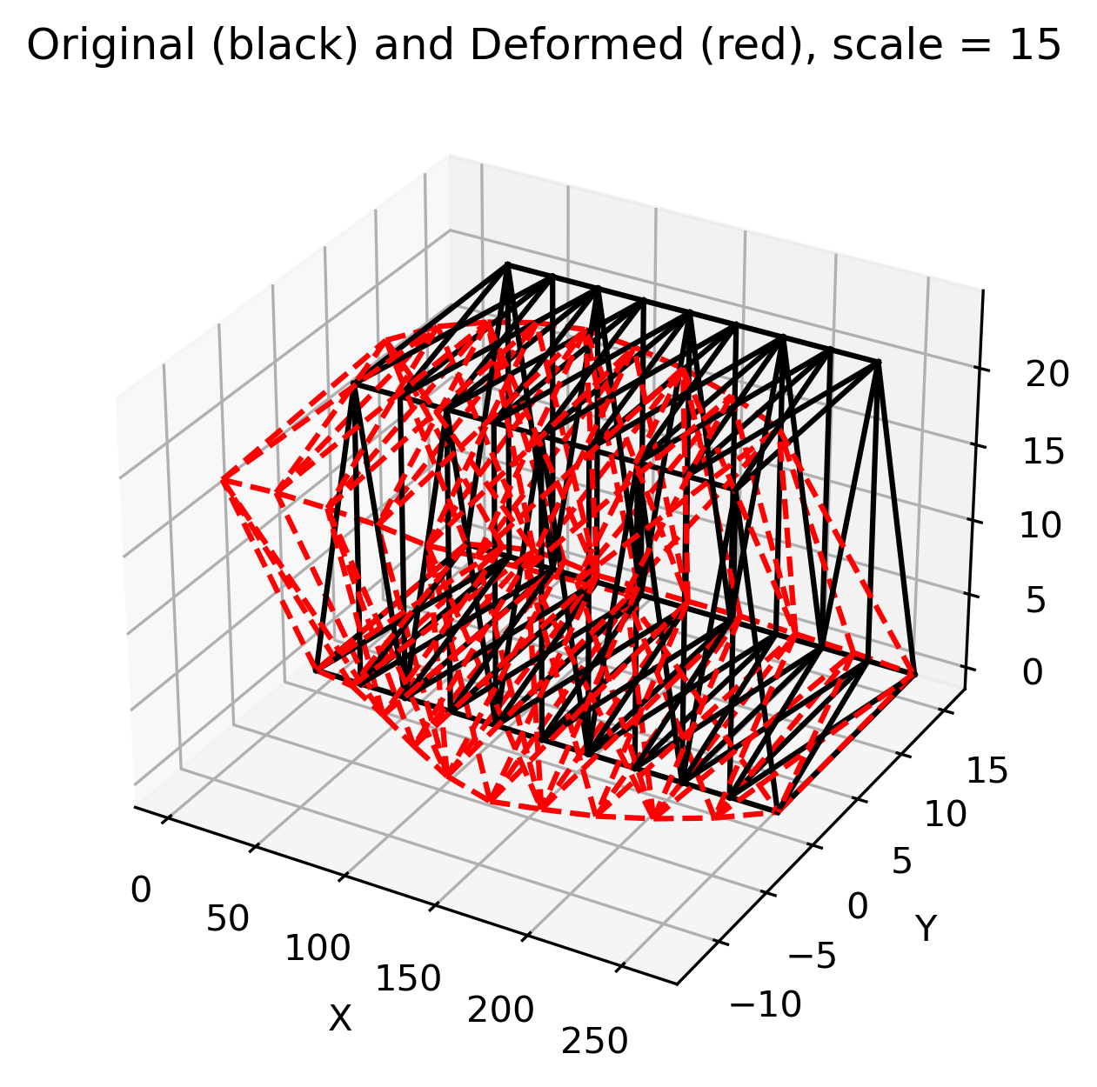
Case 2 results
Bad batch of timber / termite infestation
Modified some members to have lower stiffness
Switched primary members to have 0.3*E
Removed one beam on the bottom 0*E
Possible to replace without adding additional support?
Max displacement: -0.816 ft (2x more than base case)
Maximum axial force: 433 kips
Key things learned:
Reducing stiffness increases displacement significantly
Load redistributes to remaining members

